Slide 1
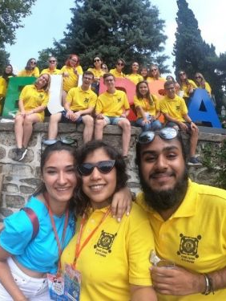

Explore somewhere new next summer
The Lions International Youth Camp & Exchange Program 2027

Slide 2
(insert name of club) Lions Club
Lions Clubs International
The Lions International Youth Camp & Exchange Program 2025

Slide 3
https://www.youtube.com/watch?v=l4M9d31AAJ0&pp=QAFIAQ%3D%3D
Lions Clubs International
A short video from our Past International President about Youth Camp & Exchange Program

Slide 4
What is the scheme all about?
International Youth Camp in each country
Host Family Stay
Encourage a healthy respect and understanding of different countries & cultures
Encouraging independence
Meeting lots of students from many different countries
Great for your CV and/or Personal Statement

Slide 5
What is the cost?
your flights to and from the country you choose
Your spending money
Your visa & insurance
Some Camps have a fee
Your food, drink and accommodation whilst in the country you choose will be met by Lions from the country you choose to visit

Slide 6

Over 100 Camps worldwide

Slide 7
Have an amazing adventure next summer!
“it was a once in a lifetime experience and being able to fully immerse myself in Japanese culture through staying with host families was something I'll always remember.”
“I was nervous about the camp at the start, but once I got there everyone was so lovely and kind, we became a mini family for a week and by the end I wished we could have had longer together”
“it's the people who bring this trip to life. I never knew that such deep bonds could be made in only 21 days but I now have friends from Brazil and Romania to Turkey and India which I have no doubt will last a lifetime”.

Slide 8


Closing date for applications: (insert date here)
Application Forms can be downloaded from the website (insert club web details here)

