Slide 1

Report and celebrate service
LEARN
Free Online Courses

Slide 2
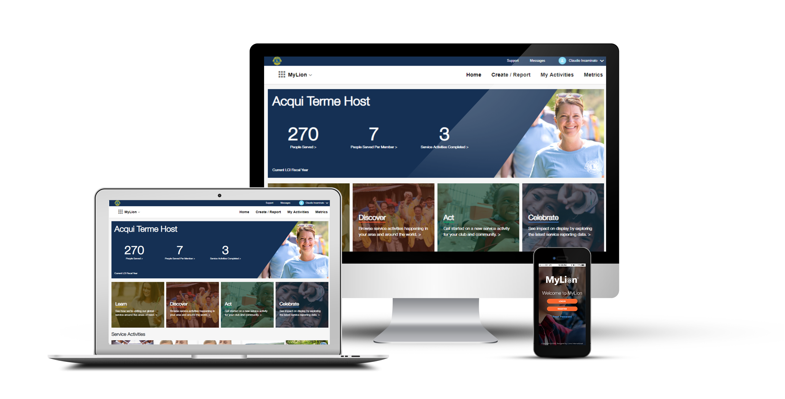
m
MyLion
  Plan, invite, and share service activities with your club
  Report service activities if you are an officer
  Find, connect and chat with Lions and Leos from all over the world
  View key service data for your club, district, multiple district, etc.
2
Notes:
MyLion is one platform that you can use on your desktop computer, laptop, tablet, mobile phone, or any device with a web browser. You can download the MyLion application on your mobile device for free, or login to MyLion from any web browser.
MyLion helps us connect and serve. With MyLion you can:
Plan upcoming service activities and take advantage of service planning resources related to all of our global causes
Quickly report your service activities if you are an officer
Send messages to other MyLion users
Explore local and global service data
Much, much more

Slide 3
REGISTRATION
Notes:
If you haven’t already created an account, you must first register. We will walk through the process now.

Slide 4
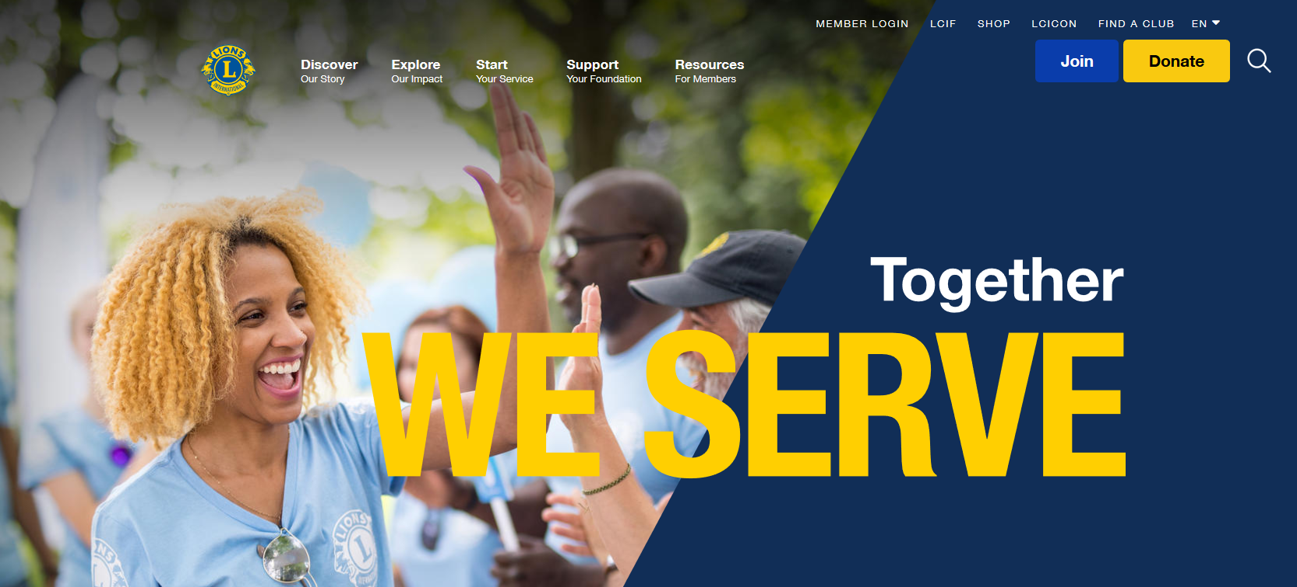
1.
Notes:
1. On lionsclubs.org, click on the MEMBER LOGIN text in the top right-hand corner

Slide 5
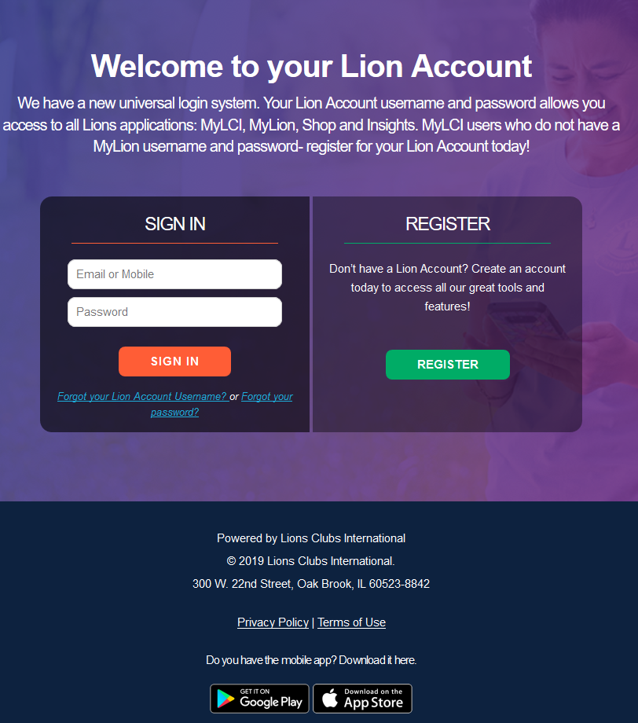
2.
Notes:
2. Select Register

Slide 6
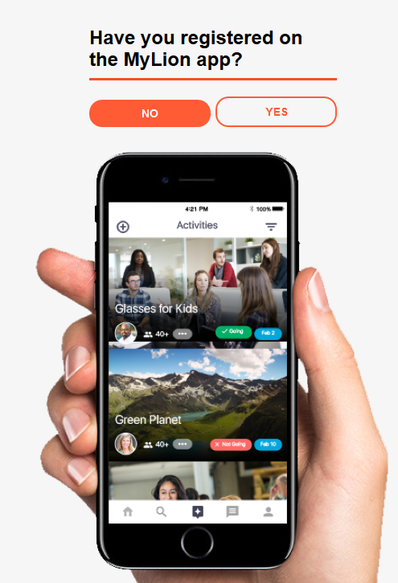
3.
Notes:
3. You will be asked if you have already created an account via the mobile app. Select No.

Slide 7
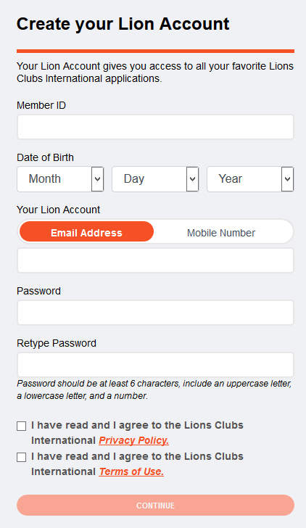
4A.
4B.
Notes:
4. (A) Enter the required information to create your account.
-- You must know your Member ID
-- Enter your date of birth (it does not need to match our system)
-- Select either your Email Address or Mobile Number as Your Lion Account user name.
(this must match our system)
-- Type in a Password
-- Select the boxes that you have read the Privacy Policy and Terms of Use.
(B) Select Continue

Slide 8
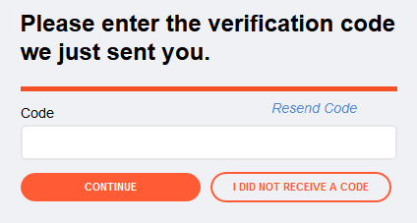
5A.
5B.
Notes:
5. (A) Retrieve the code that was sent to your email or mobile phone and enter the code (B) Select Continue

Slide 9
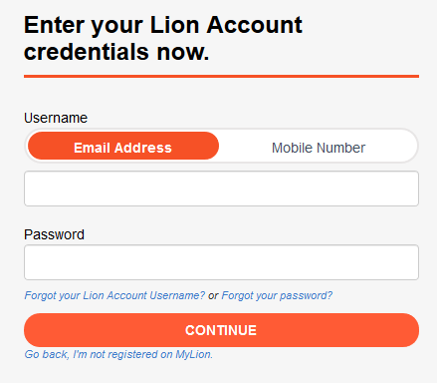
6A.
6B.
Notes:
6. (A) Complete the login process by entering either the email address or mobile number used during registration and the password you created (B) Select Continue

Slide 10
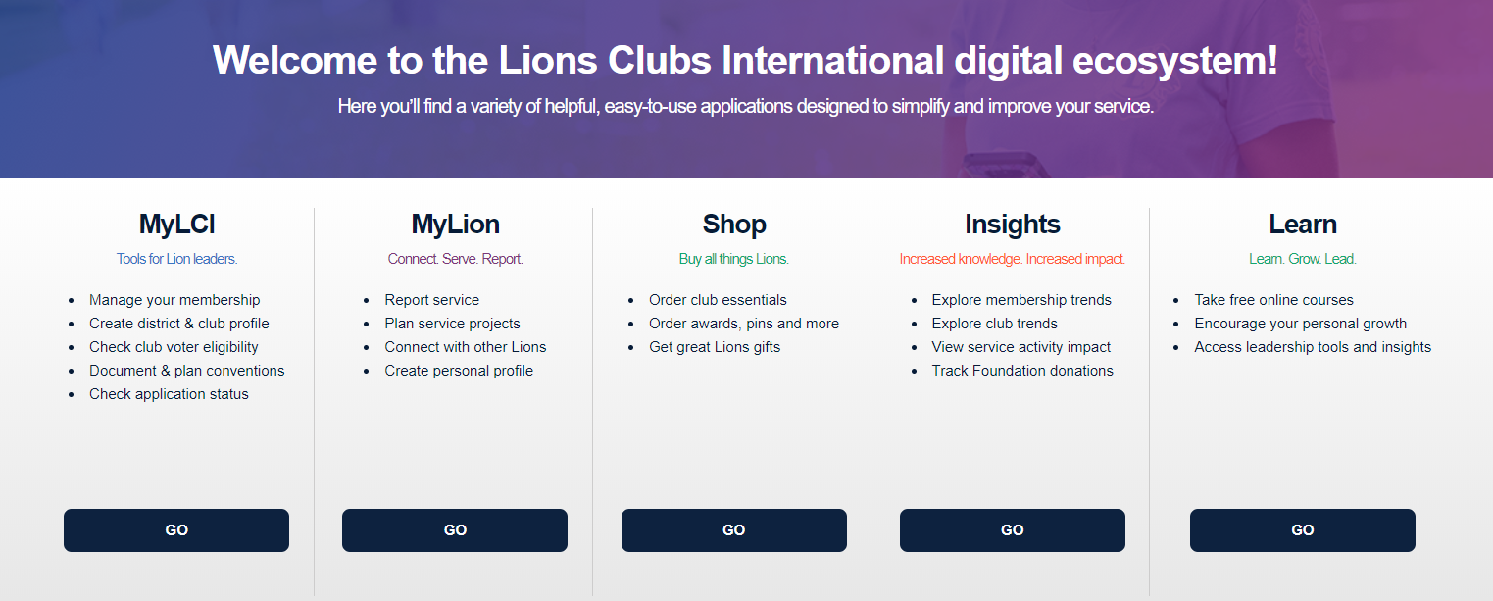
Notes:
Once logged in, you will land on your account page

Slide 11
REPORTING SERVICE
(Report the old way)
Notes:
We will now walk through the old way of reporting a service activity.

Slide 12
1.
Notes:
1. Select MyLion®

Slide 13
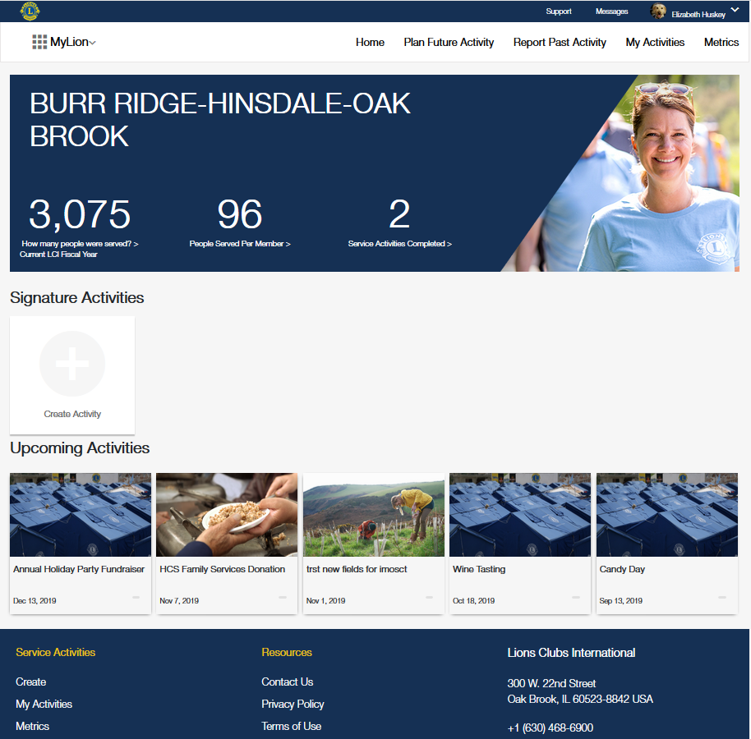
2.
Notes:
2. Select the “Report Past Activity” option at the top of the page

Slide 14
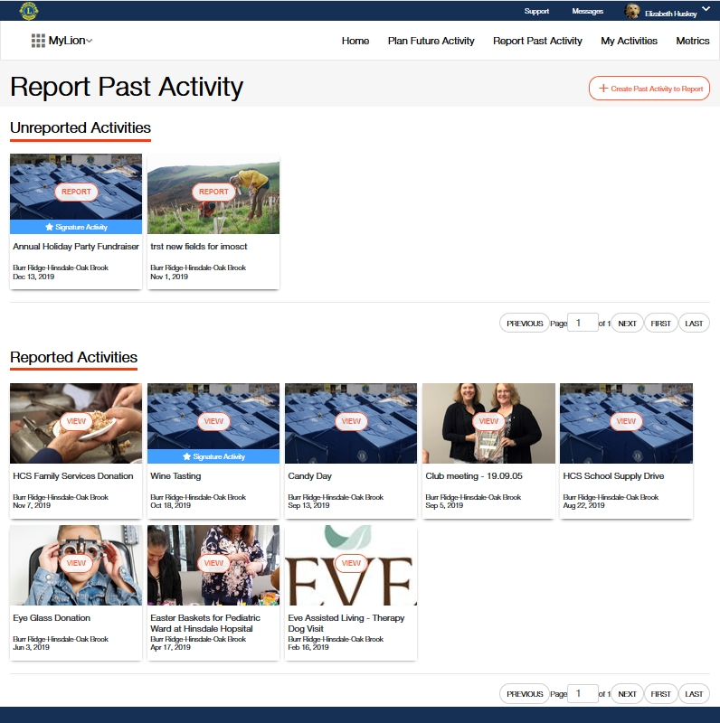
3.
Notes:
3. Click “create past activity to report”
(Must be a reporting officer)

Slide 15
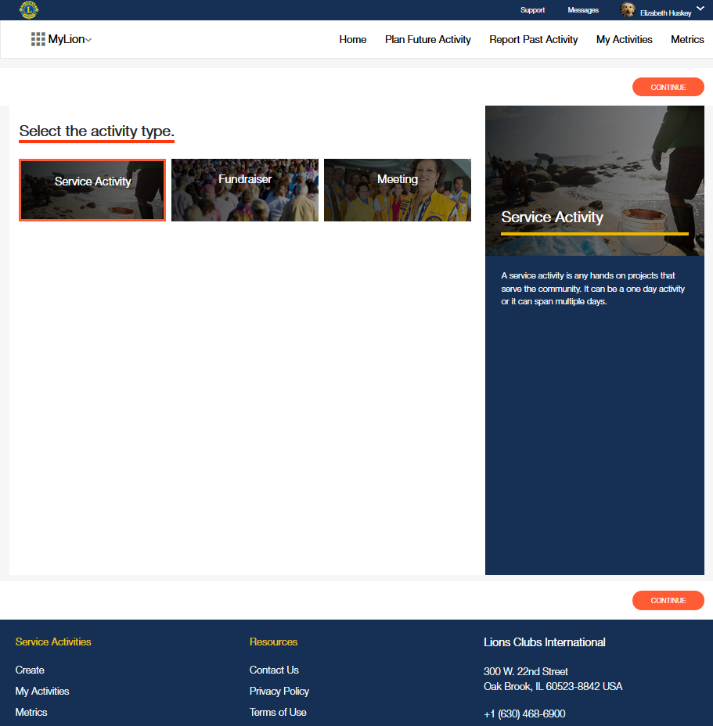
4B.
4A.
Notes:
4. (A) Select activity type (B) Click continue

Slide 16
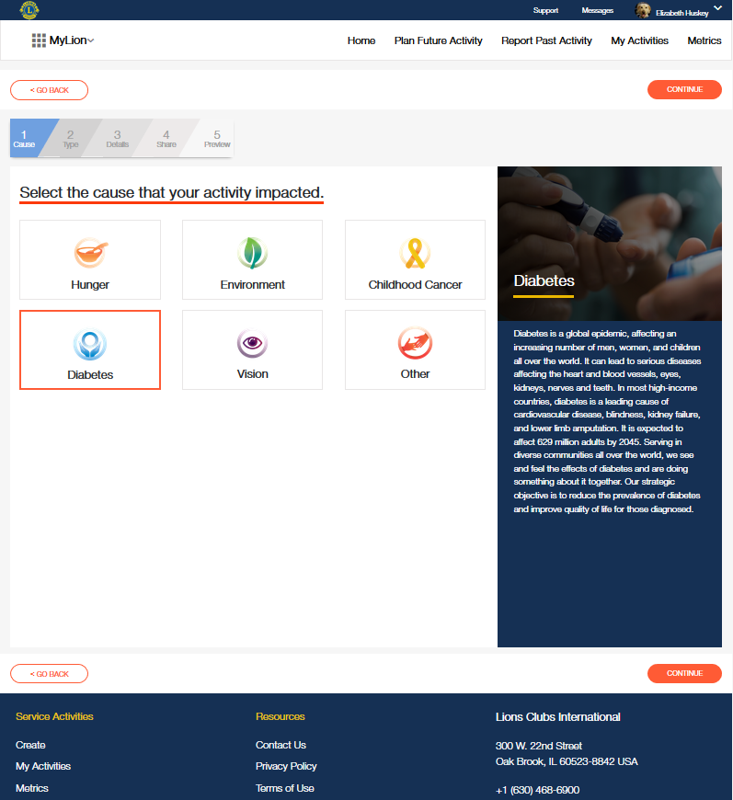
5B.
5A.
Notes:
7. (A) Select Cause (B) Click continue

Slide 17
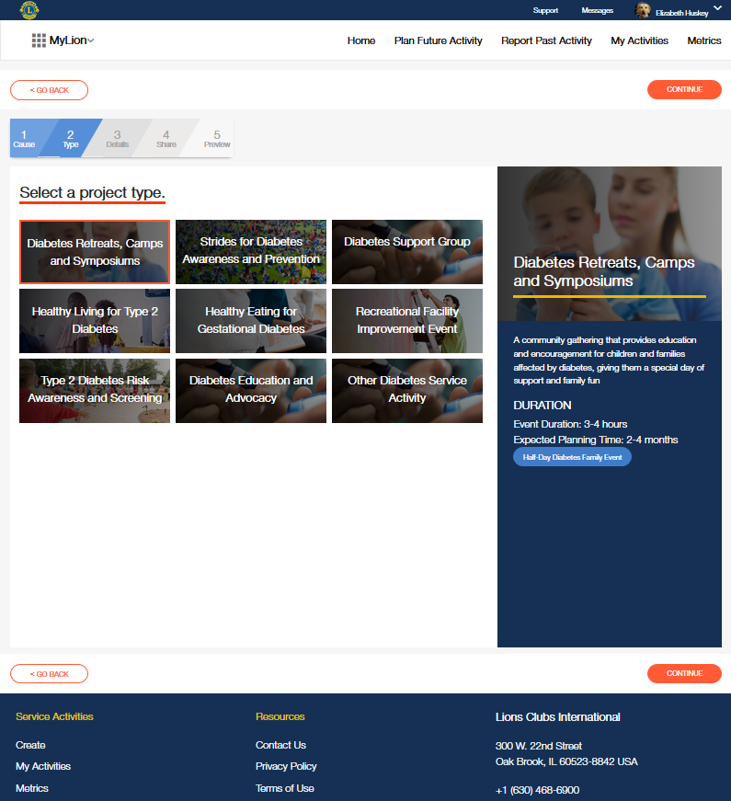
6B.
6A.
Notes:
6. (A) Choose a project that applies or choose other (B) Click continue

Slide 18
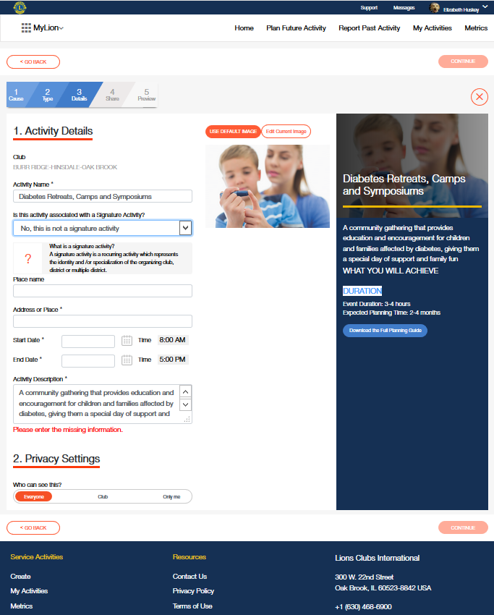
7D.
7C.
7A.
7B.
Notes:
7. (A) Fill in your activity details (must be a date range in the past) (B) Select your privacy settings (C) Upload an image (D) Click continue

Slide 19
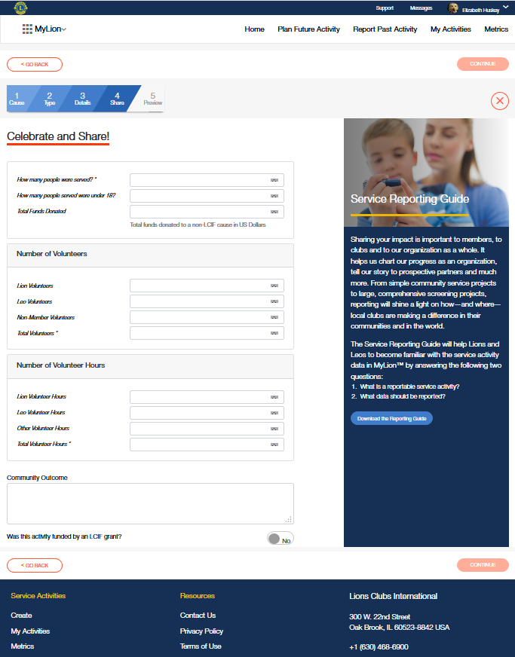
8B.
8A.
Notes:
8. (A) Share the impact of your activity by filling in the required fields (B) Click continue

Slide 20
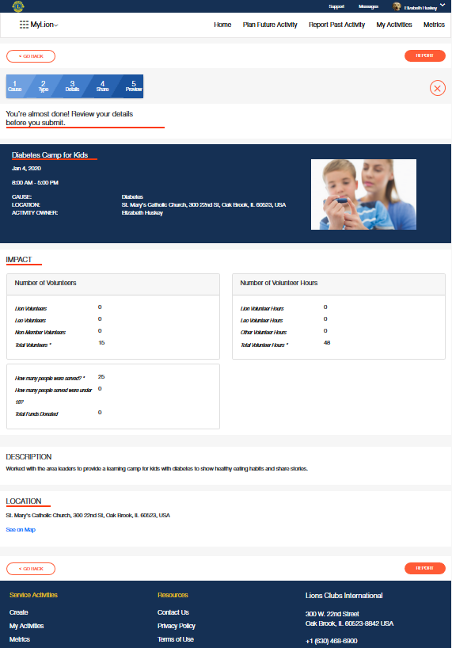
9B.
9A.
Notes:
9. (A) Review the details of your activity (B) Click “report”

Slide 21
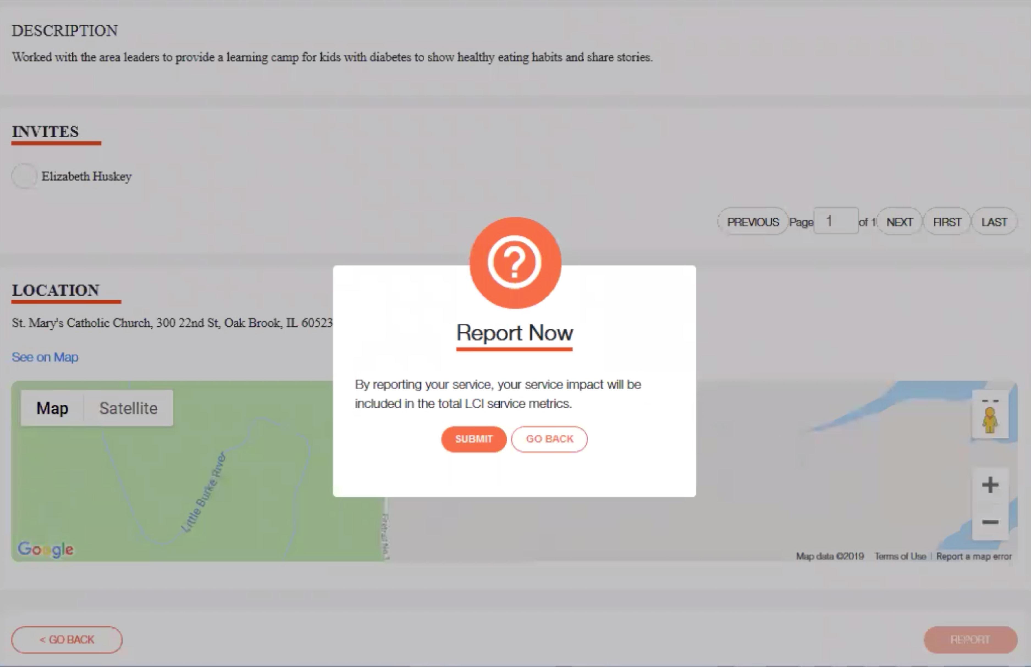
10.
Notes:
10. Click “submit” on the pop-up, and you’re done!

Slide 22
REPORTING SERVICE
(Report the new way)

Slide 23
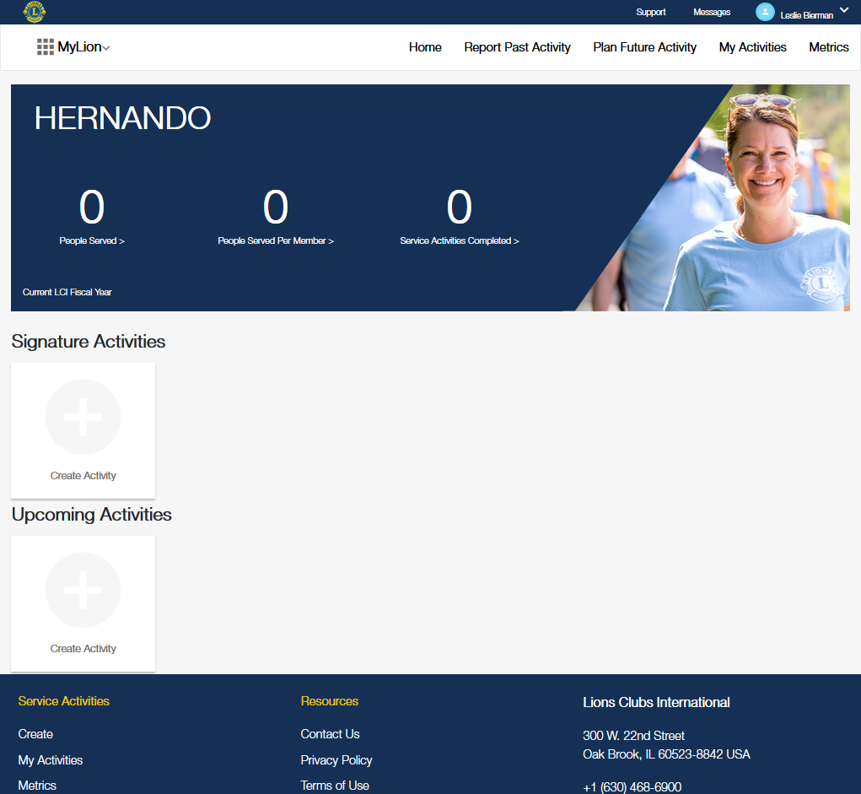
1.
Notes:
1. Select the “Report Past Activity” option at the top of the page
**Note it is now listed 2nd in the menu

Slide 24
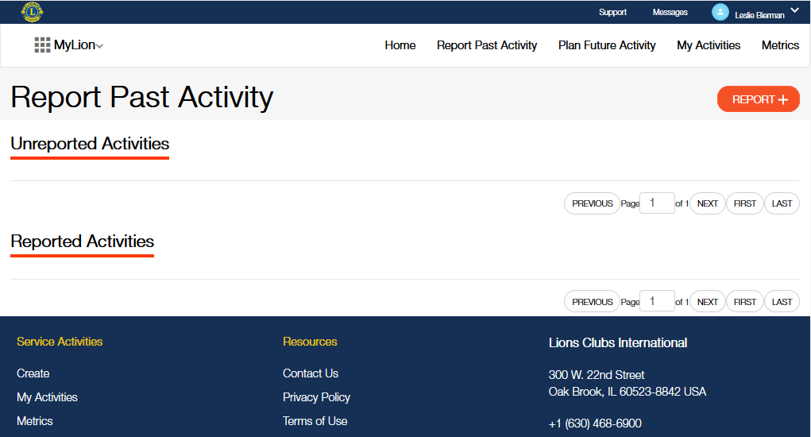
2.
Notes:
2. Select the Report + button
**Must be a reporting officer to see this button

Slide 25
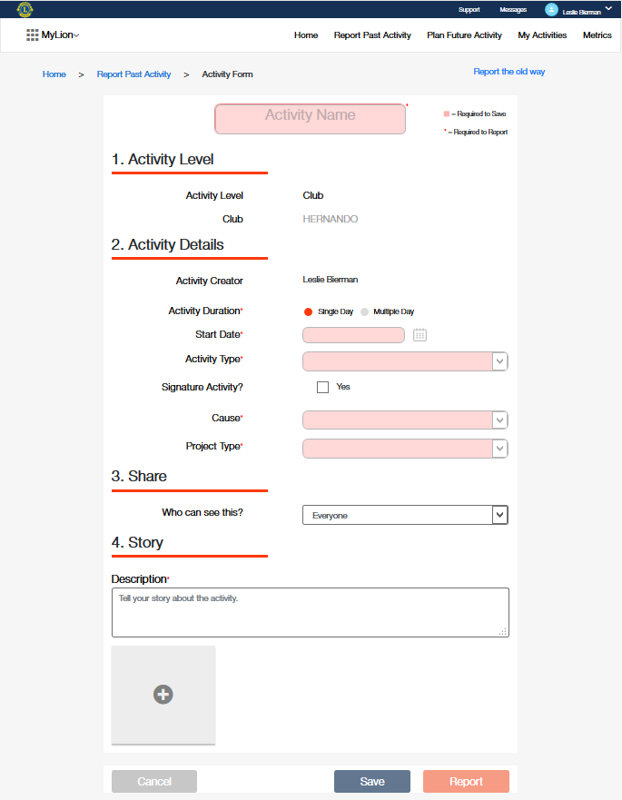
3A.
3B.
Notes:
3. (A) Complete the sections of the form
-- Fields with red boxes are required to save your work
-- Fields with red asterisks are required to report the activity to LCI
(B) Select Report

Slide 26
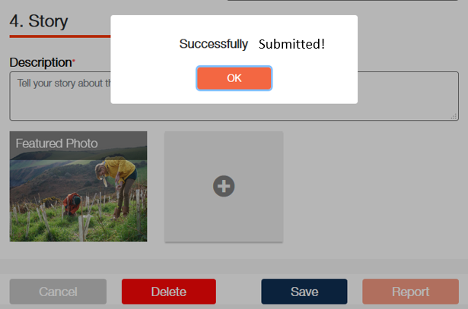
4.
Notes:
4. Select Ok

Slide 27
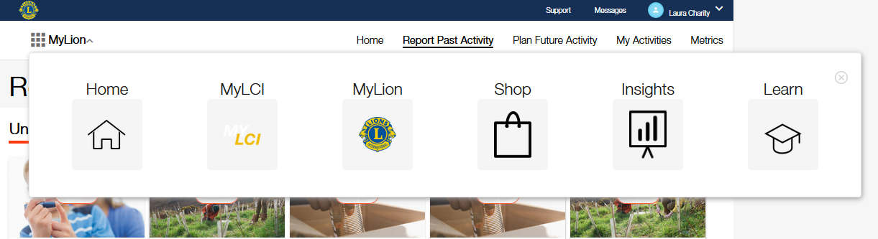
5A.
5B.
Notes:
5. (A) From within MyLion, select the App Selection feature in the top left corner of the page. (B) Select Learn from the application menu
**Note: Selecting the ‘Home’ option from the application menu will bring you to the Account page where you can also select Learn.

Slide 28
5C.
Notes:
(C) If you selected Home from the App Selector, you will return to your account page. Select Learn.

Slide 29

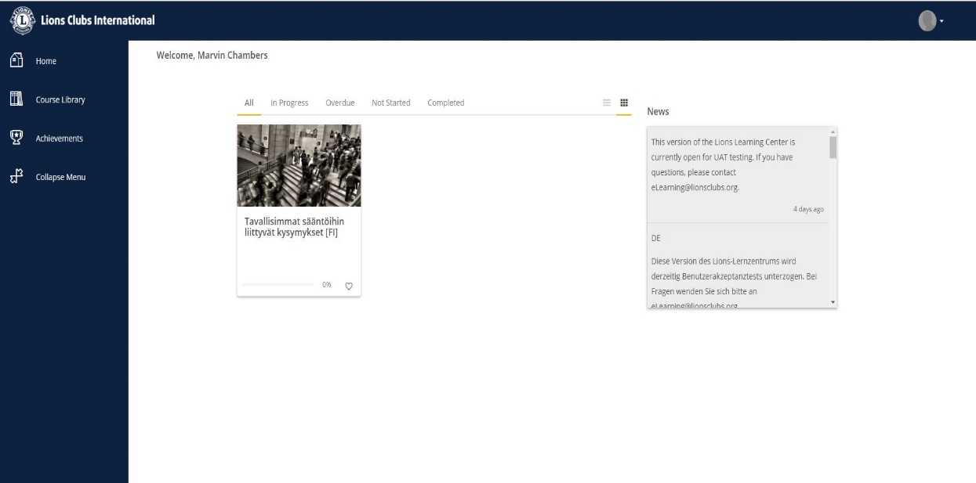
m
Learn
  Take free online courses
  Access Leadership tools and insights
  Encourage your personal growth
  Plan and report training by GLT Coordinators
29

Slide 30
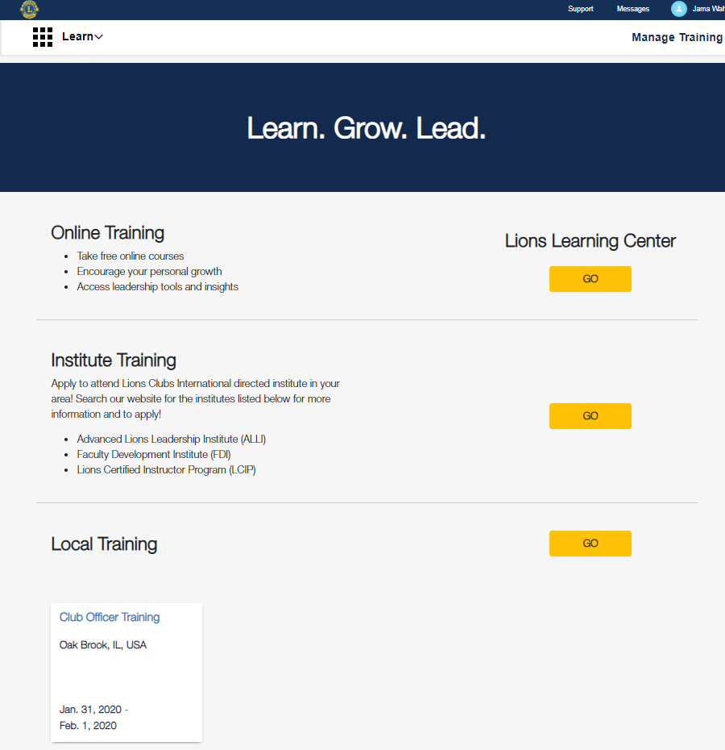
1.
Notes:
NOTE: This slide and the following screen shots are from the TEST site for Learn and contains sample test data.
Learn is accessible to all Lions & Leos
This is a screen shot of the current Learn landing page. There are three sections:
Online Training – a direct link to the upgraded Lions Learning Center (LLC)
Institute Training – (phase 2 – for now… a link to our lionsclubs.org site where interested Lions or Leos may search for more information on LCI-directed institutes
Local Training – locally organized training that is shared by the GAT-GLT MD and/or district coordinator. Clicking on “Go” will land on the Local Training page in Learn where Lions and Leos may see the complete published calendar of local training as shared by their MD and/or district coordinator.
1. Select Go for Local Training

Slide 31
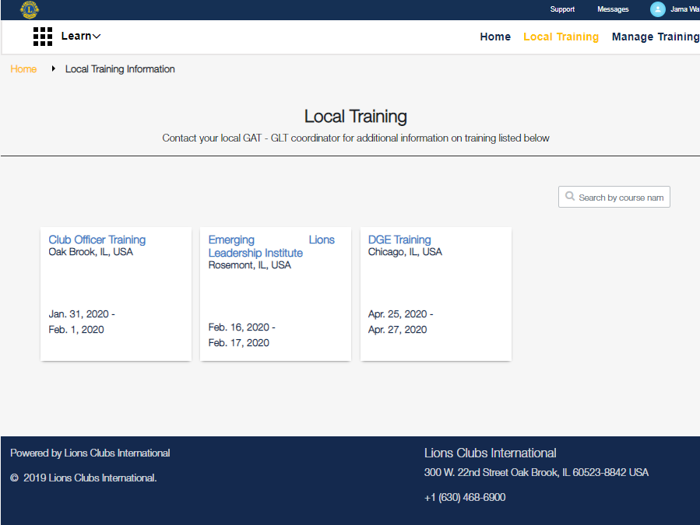
2.
Notes:
This is an example of what a Lion or Leo might see when they access the Local Training page. Training that was submitted and published by their MD and/or district coordinator is future dated, would appear here.
2. Select a tile (Lions or Leos may click on any of these tiles to obtain more information about any training)

Slide 32
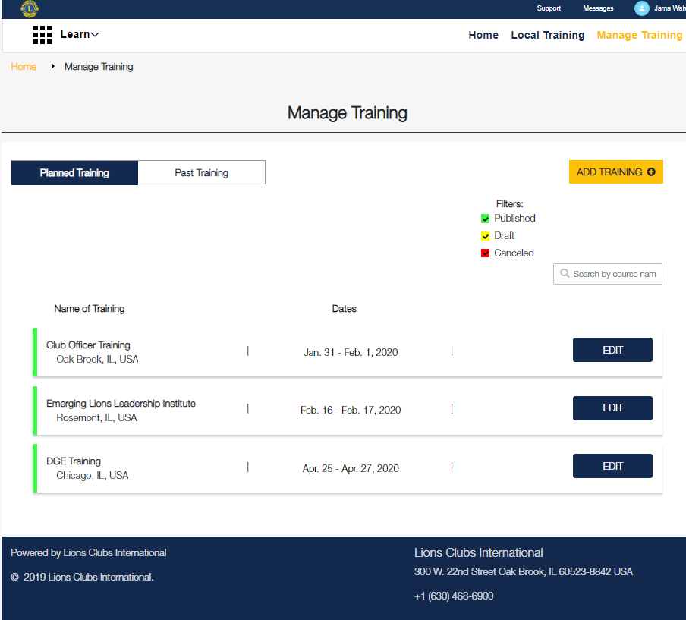
3A.
3B.
3C.
Notes:
Manage Training is only open to a GLT D or MD coordinator.
This is an extra section for the GAT-GLT MD and district coordinators so can share and report training.
3. (A) Select Manage Training
(B) Select Add Training to add future trainings.
(C) Select Edit to update saved (as a Draft or Published) trainings or cancel trainings.

Slide 33
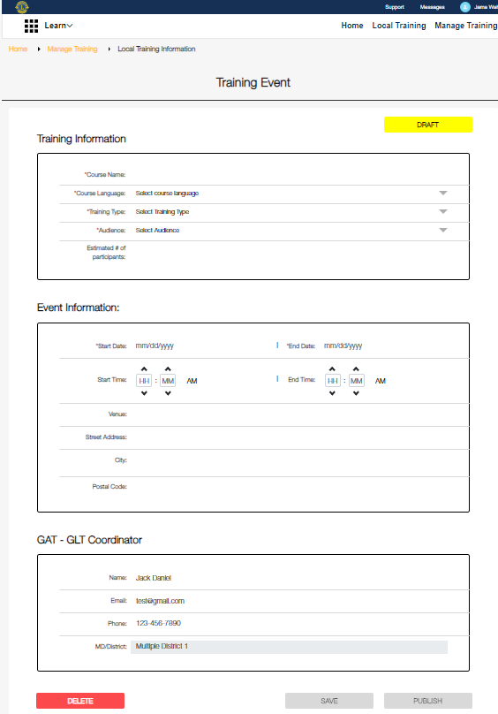
4A.
4B.
Notes:
4. (A) Enter the information about the course (B) Select Publish
This information is viewable by a Lion or Leo if they clicked on a Training tile.
***Note: GAT – GLT Coordinator Section: Each GAT-GLT coordinator has the ability to edit and delete any coordinator information (except MD or district number). If a GAT-GLT coordinator chooses to not share their contact information, a standard message would direct Lions and Leos to “contact your local GAT-GLT coordinator for more information.”

Slide 34
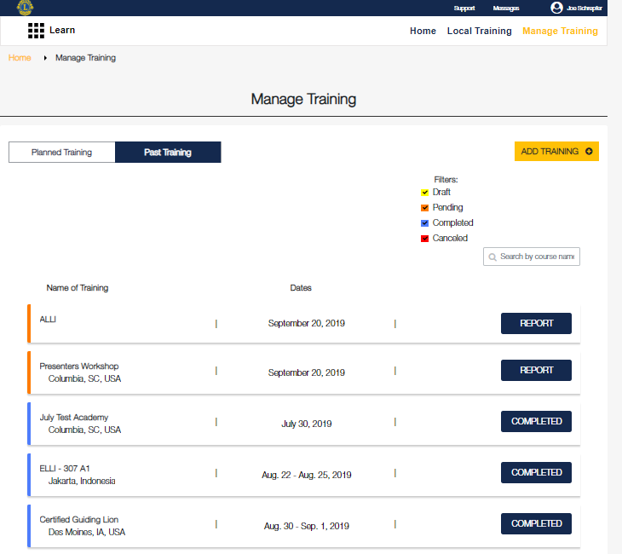
5A.
5B.
Notes:
5. (A) Select Past Training (B) Select Report
The GAT-GLT coordinator will report on the completed training. The coordinator will enter faculty and participant names. Once all names are entered, the training will be officially marked as complete. Once a training is complete, no further edits may be made.
This section is completely private. The GAT-GLT coordinator who submitted the faculty and participant information will be the only members able to view what was submitted on this page. Select staff will have admin rights to support the GAT-GLT coordinators and will have access to correct any errors.

Slide 35
Thank you!
© 2019 Lions Clubs International

